Slide 1
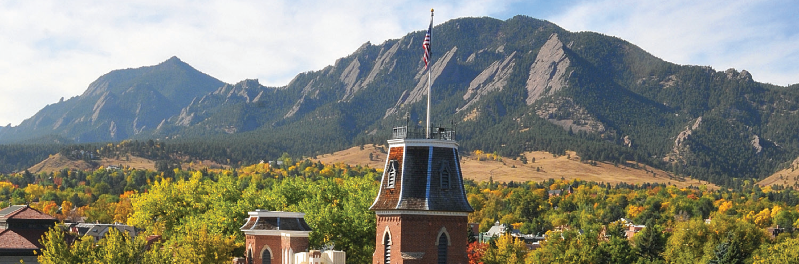
Setting up LLMs on CURC Resources

Slide 2
Setting up LLMs on CURC Resources
Instructor: Brandon Reyes
Research Computing
Website: www.colorado.edu/rc
Documentation: https://curc.readthedocs.io
Helpdesk: support request form
Survey: http://tinyurl.com/curc-survey18

Slide 3


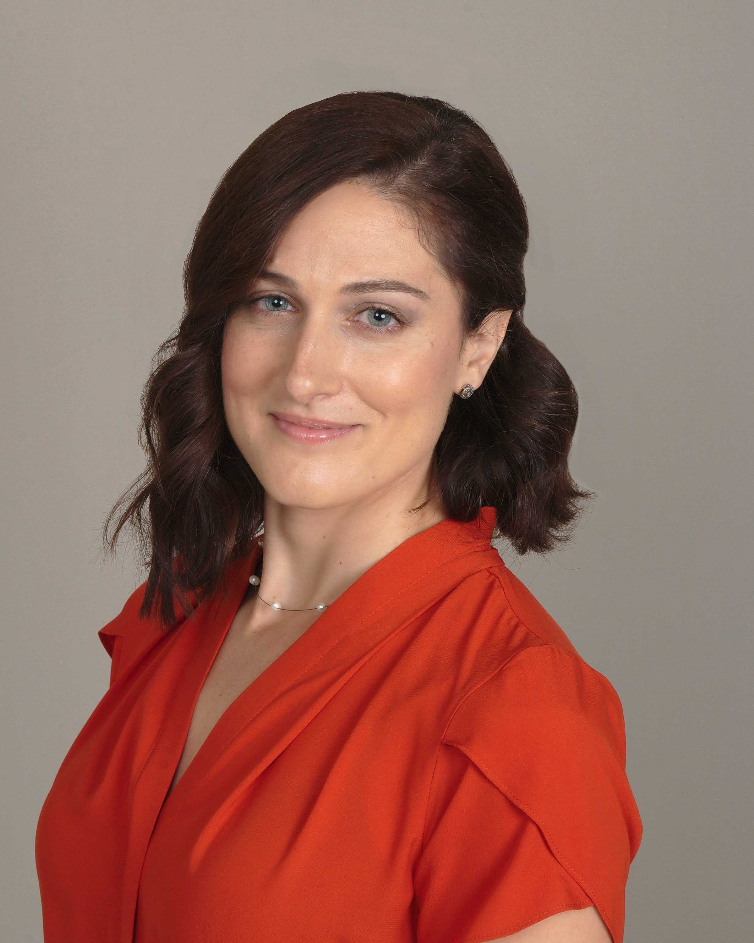







Meet the User Support Team
Layla Freeborn
Brandon Reyes
Andy Monaghan
Michael Schneider
John
Reiland
Dylan Gottlieb
Mohal Khandelwal
Ragan
Lee

Slide 4

Slides: https://github.com/ResearchComputing/setting_up_llms_on_curc_resources_rc_short_course

Slide 5
Session Overview
Background on LLMs
Accessing CURC hosted LLMs
Running Ollama
Running Transformers by Hugging Face

Slide 6
What are LLMs?
Large Language Models (LLMs) are types of artificial intelligence models that are trained on large amounts of data, which enables them to “understand” and generate natural language. They are great at:
Summarizing material
Constructing code (if they are trained for coding tasks)
Conversational tasks
Generating text
When you break it down, LLMs are made possible by multiplication, addition, and non-linear transformations. This allows them to run very quickly on GPUs.

Slide 7
Important Considerations for LLMs
Not all LLMs are equal, some are trained for specific tasks, such as code generation
The type of data the LLMs are trained on determines what they can do
General models (ChatGPT, Gemini) are great for common knowledge tasks, but can fall short in certain technical areas
Bigger is not always better
You can have small LLMs that are extremely performant for a certain task
LLMs can “hallucinate”. Put simply, this means they can generate incorrect answers or content that may sound plausible
Don’t treat LLMs as if they are all-knowing! They are not … yet

Slide 8
Proprietary vs Open-Source LLMs
Models such as ChatGPT are proprietary and require that you run the model on their dedicated hardware
Pros: these companies have a lot of resources, allowing for quicker access and their models are usually state-of-the-art
Cons: Data privacy and cost
Open-source LLMs can be ran anywhere
Pros: you can run them for free on CURC resources, your data stays on CURC’s system, and there are some very capable open-source models
Cons: proprietary models are not going to be available and complex LLMs can consume a lot of GPU memory

Slide 9
What is an LLM framework?
In the past, running an LLM locally took quite a bit of effort. However, now there are several LLM frameworks available.
An LLM framework allows for a user-friendly way to access LLMs and utilize them
Can enable access to proprietary or local LLMs
Can enable running the LLM from the command line or within a script
Notes:
Now that we know why we would like to run an LLM locally, how do we do that?

Slide 10
Common LLM Frameworks
There are many LLM frameworks out there, some with their own unique functionality. However, in this talk we will focus on two extremely popular LLM frameworks that enable you to run models locally:
Ollama
Transformers by Hugging Face

Slide 11
Ollama
Ollama is an LLM framework maintained by Meta
It is open-source and extremely beginner friendly
Enables users to run LLMs locally and retrieve models
Easily installable models are curated by Ollama
Available models can be seen at https://ollama.com/search
You can use other models, but you need to convert them to a compatible format
With Ollama, you establish a server and then use this server to install, manage, and run LLMs

Slide 12
Transformers by Hugging Face
Transformers is an LLM framework maintained by Hugging Face and is extremely popular
It is open-source and contains additional functionality that Ollama does not have, such as the ability to train models
Enables users to run LLMs locally and retrieve models
Does not require you to setup a server like Ollama

Slide 13
What is Quantization and Instruct?
Quantization
When training, most LLMs use either single or double precision. This can make those models consume a lot of memory.
Quantization allows you to reformat the model into a lower-precision format, which makes the model consume less memory.
Instruct
Instruct or instruction models are ideal for specifying tasks for the LLM to perform and are the models used in common chat interfaces.

Slide 14
Before we jump into things …

Slide 15
Before running or working with LLMs on CURC resources, please be sure that you are adhering to all CURC User Policies and CU’s policies and guidance around Artificial Intelligence outlined in the pages Artificial Intelligence at CU Boulder and Resources & Guidance.

Slide 16
What resources should you run on?
Most popular LLMs need a GPU to run in a timely manner
On our system, we have both AMD and NVIDIA GPUs
The modules we have on our system for Ollama and Transformers are only compatible with CPU and NVIDIA GPU nodes
We recommend that you run on our aa100, al40, or atesting_a100 partitions
The atesting_a100 partition is only for testing, debugging, and compiling programs
The al40 partition has L40 GPUs that can be great for inference (evaluating LLMs)
The aa100 partition has A100 GPUs that can be better for training LLMs
atesting_a100 interactive session example:
$ sinteractive --partition=atesting_a100 --qos=testing --nodes=1 --ntasks=10 --gres=gpu --time=60

Slide 17
Accessing CURC hosted LLMs
To streamline access and reduce redundant storage of LLMs, CURC has created a shared space for common LLMs
This is a CURC managed space, you cannot store models in this space
If you do think a model should be here, reach out to us!
All models can be accessed using the environment variable CURC_LLM_DIR
You must be on a compute node to get access to this variable and the provided LLMs

Slide 18
CURC hosted Ollama Compatible LLMs
gpt-oss:20b
An open-source model from OpenAI (ChatGPT folks)
Requires about 14 GB of GPU memory
gemma3:12b
An open-source model from Google (a derivative of Gemini)
Requires around 8 GB of GPU memory
llama3.1:8b
An open-source model from Meta
Requires about 5 GB of GPU memory
embeddinggemma:latest
An open-source embedding model from Google (used for generating vector representations, not for chatting)
Requires about 1 GB of GPU memory
All of these are quantized, instruct models (only non-embedding models), and available at:
$CURC_LLM_DIR/ollama

Slide 19
CURC hosted Transformer Compatible LLMs
gpt-oss-20b
This model has been quantized
Requires about 14 GB of GPU memory
gemma-3-12b-it
This model has not been quantized
Without quantization, requires more than 20 GB of GPU memory
Llama-3.1-8B-Instruct
This model has not been quantized
Without quantization, requires more than 20 GB of GPU memory
All of these models are instruct models and available at:
$CURC_LLM_DIR/hf-transformers

Slide 20
Using CURC’s Ollama install
The latest version of Ollama is available via our module stack. Once on a compatible compute node, you can load the module using:
module load ollama
Starts an Ollama server for you and sets all necessary environment variables
Uses CURC’s hosted LLMs by default
If you would like to point to your own directory that contains LLMs, this can be done with:
export OLLAMA_MODELS=/projects/$USER/my_ollama_models; module load ollama
This module is only available on CPU nodes and NVIDIA GPU nodes. We only provide the most up-to-date version, and these versions will be updated during each planned maintenance

Slide 21
Useful Ollama Commands
ollama list
Lists all available models
ollama pull <model>
Downloads a model if it does not exist, otherwise updates the model
ollama run <model>
Runs the model from the command line and downloads the model if it does not exist
ollama rm <model>
Removes the specified model

Slide 22
Accessing Ollama in Python
To use Ollama within Python, you must install the appropriate packages. We have created a minimal uv environment for this. You can obtain access to this environment using:
module load uv
source $CURC_UV_ENV_DIR/ollama-python-api-env/bin/activate
Note: The Ollama server needs to be running before you run your code.

Slide 23
Example Ollama Python script
ollama_test.py
from ollama import chat
from ollama import ChatResponse
response: ChatResponse = chat(model='llama3.1:8b', messages=[
{
'role': 'user',
'content': 'In one sentence, how cool is CU Research Computing?',
},
])
print(response.message.content)
To run this script from the command line:
(ollama-python-api-env) $ python ollama_test.py

Slide 24
Installing Ollama
As noted, our modules only install the newest version of Ollama that is available during our planned maintenance. Sometimes you need an older or newer version. We provide extremely detailed instructions for installing both Ollama and setting up the Ollama Python package via uv in the “Self-install instructions” tab:
https://curc.readthedocs.io/en/latest/ai-ml/llms.html#ollama

Slide 25
Transformers by Hugging Face
Models are not as easy to install as Ollama
Pros:
Provides access to cutting-edge LLMs and datasets: https://huggingface.co/
Provides access to community driven models and models without quantization
Cons:
Most well-known models require a Hugging Face account and the acceptance of terms of use to download
If the model uses a different library to run, you have to install those dependencies
Community driven models and datasets are sometimes not vetted

Slide 26
Let’s take a look at a model card!
https://huggingface.co/google/gemma-3-12b-it

Slide 27
Using CURC’s Transformers install
The latest version of Transformers is available via our module stack. Once on a compatible compute node, you can load the module using:
module load hf-transformers
Loads base packages using uv and sets general environment variables
Unlike Ollama, Transformers isn’t connected to CURC’s LLM directory (more on this later)
This module is only available on CPU nodes and NVIDIA GPU nodes. We only provide the most up-to-date version, and these versions will be updated during each planned maintenance

Slide 28
Installing Transformers
As noted, our modules only install the newest version of Transformers that is available during our planned maintenance. Sometimes you need an older or newer version. We provide extremely detailed instructions for installing Transformers via uv in the “Self-install instructions” tab:
https://curc.readthedocs.io/en/latest/ai-ml/llms.html#transformers-by-hugging-face

Slide 29
Downloading models
You must have a Hugging Face account
You need to generate a user access token
Once your account is setup, you can install models using:
hf download --local-dir <install-directory> <hf-model>
For in-depth instructions, see https://curc.readthedocs.io/en/latest/ai-ml/llms.html#downloading-transformers-compatible-models

Slide 30
Example Transformers Python script
from transformers import AutoTokenizer, AutoModelForCausalLM
import os
# Get our system-defined path to CURC's shared LLMs
CURC_LLM_DIR = os.getenv('CURC_LLM_DIR')
# Specify that we want to use the gpt-oss-20b model that is in CURC's shared LLM directory
path_to_model=f"{CURC_LLM_DIR}/hf-transformers/gpt-oss-20b"
# Obtain the model-defined tokenizer
tokenizer = AutoTokenizer.from_pretrained(path_to_model)
# Load the model onto the GPU and do not apply quantization
model = AutoModelForCausalLM.from_pretrained(path_to_model, device_map="cuda")
# Specify the task we want the LLM to perform
messages = [{"role": "user", "content": "Write a paragraph about cookies."}]
# Format the input we will provide to the LLM and load this onto the GPU
inputs = tokenizer.apply_chat_template(messages, add_generation_prompt=True, tokenize=True, return_dict=True, return_tensors="pt").to(model.device)
# Generate the LLM response
outputs = model.generate(**inputs, max_new_tokens=200)
# Print the provided LLM response
print(tokenizer.decode(outputs[0][inputs["input_ids"].shape[-1]:]))

Slide 31
Example Transformers Python script
Let’s name our previous script no_quant.py. To run this script, we first need to make sure that the model has been installed. Once the model has been installed, we can run this script from the command line as follows:
(hf-transformers-env) $ python no_quant.py

Slide 32
Adding Quantization
As mentioned before, some models (Llama-3.1-8B-Instruct) will not fit on a smaller GPU. For this reason, you need to Quantize the model. For those models that use PyTorch, this can be done using Bitsandbytes. This is straightforward and requires only the addition/modifications below:
from transformers import BitsAndBytesConfig
import torch
# Use QLoRA or 4-bit quantization
bnb_config = BitsAndBytesConfig( load_in_4bit=True,bnb_4bit_quant_type="nf4", bnb_4bit_use_double_quant=True, bnb_4bit_compute_dtype=torch.bfloat16 )
# Load the model onto the GPU and apply quantization using bitsandbytes
model = AutoModelForCausalLM.from_pretrained(path_to_model, device_map="cuda", quantization_config=bnb_config, dtype=torch.bfloat16)

Slide 33
Streaming to the command line
While in an interactive session, we can stream the output of the LLM in real-time by modifying the “model.generate” call with the following:
from transformers import TextStreamer
streamer = TextStreamer(tokenizer)
output = model.generate(**inputs, max_new_tokens=200, streamer=streamer)

Slide 34

Thank you!
http://tinyurl.com/curc-survey18
Survey and feedback

Slide 35
Slides: https://github.com/ResearchComputing/setting_up_llms_on_curc_resources_rc_short_course

